Slide 1
Chapter 23 Project Planning

Slide 2
Topics covered
Software pricing
Plan-driven development
Agile planning
Project scheduling
Work Break Down Structure (WBS)
Estimation techniques
COCOMO cost Modeling

Slide 3
Project planning
Project planning involves breaking down the work into parts and assign these to project team members, anticipate problems that might arise and prepare tentative solutions to those problems.
The project plan, which is created at the start of a project, is used to communicate how the work will be done to the project team and customers, and to help assess progress on the project.

Slide 4
Planning stages
At the proposal stage, when you are bidding for a contract to develop or provide a software system.
During the project startup phase, when you have to plan who will work on the project, how the project will be broken down into increments, how resources will be allocated across your company, etc.
Periodically throughout the project, when you modify your plan in the light of experience gained and information from monitoring the progress of the work.

Slide 5
Software Pricing

Slide 6
Software Pricing
Estimates are made to discover the cost, to the developer, of producing a software system.
You take into account, hardware, software, travel, training and
effort costs.
There is not a simple relationship between the development cost and the price charged to the customer.
Broader organisational, economic, political and business considerations influence the price charged.

Slide 7
Factors affecting software Pricing
Factor | Description
Contractual terms | A customer may be willing to allow the developer to retain ownership of the source code and reuse it in other projects. The price charged may then be less than if the software source code is handed over to the customer.
Cost estimate uncertainty | If an organization is unsure of its cost estimate, it may increase its price by a contingency over and above its normal profit.
Financial health | Developers in financial difficulty may lower their price to gain a contract. It is better to make a smaller than normal profit or break even than to go out of business. Cash flow is more important than profit in difficult economic times.

Slide 8
Factors affecting software Pricing
Factor | Description
Market opportunity | A development organization may quote a low price because it wishes to move into a new segment of the software market. Accepting a low profit on one project may give the organization the opportunity to make a greater profit later. The experience gained may also help it develop new products.
Requirements volatility | If the requirements are likely to change, an organization may lower its price to win a contract. After the contract is awarded, high prices can be charged for changes to the requirements.

Slide 9
Pricing Strategies
Under pricing
A company may underprice a system in order to gain a contract that allows them to retain staff for future opportunities
A company may underprice a system to gain access to a new
market area
Increased pricing
The price may be increased when a buyer wishes a fixed-price contract and so the seller increases the price to allow for unexpected risks

Slide 10
Pricing to win
The software is priced according to what the software developer believes the buyer is willing to pay.
If this is less that the development costs, the software functionality may be reduced accordingly with a view to extra functionality being added in a later release.
Additional costs may be added as the requirements change and these may be priced at a higher level to make up the shortfall in the original price.

Slide 11
Plan-driven Development

Slide 12
Plan-driven Development
Plan-driven or plan-based development is an approach to software engineering where the development process is planned in detail.
Plan-driven development is based on engineering project management techniques and is the ‘traditional’ way of managing large software development projects.
A project plan is created that records the work to be done, who will do it, the development schedule and the work products.
Managers use the plan to support project decision making and as a way of measuring progress.

Slide 13
Plan-driven Development
The arguments in favor of a plan-driven approach are that early planning allows organizational issues (availability of staff, other projects, etc.) to be closely taken into account, and that potential problems and dependencies are discovered before the project starts, rather than once the project is underway.
The principal argument against plan-driven development is that many early decisions have to be revised because of changes to the environment in which the software is to be developed and used.

Slide 14
Project plans
In a plan-driven development project, a project plan sets out the resources available to the project, the work breakdown and a schedule for carrying out the work.
Plan sections
Introduction
Project organization
Risk analysis
Hardware and software resource requirements
Work breakdown
Project schedule
Monitoring and reporting mechanisms

Slide 15
Project plan supplements
Plan | Description
Configuration management plan | Describes the configuration management procedures and structures to be used.
Deployment plan | Describes how the software and associated hardware (if required) will be deployed in the customer’s environment. This should include a plan for migrating data from existing systems.
Maintenance plan | Predicts the maintenance requirements, costs, and effort.
Quality plan | Describes the quality procedures and standards that will be used in a project.
Validation plan | Describes the approach, resources, and schedule used for system validation.

Slide 16
Planning Assumptions
You should make realistic rather than optimistic assumptions when you are defining a project plan.
Problems of some description always arise during a project, and these lead to project delays.
Your initial assumptions and scheduling should therefore take unexpected problems into account.
You should include contingency in your plan so that if things go wrong, then your delivery schedule is not seriously disrupted.

Slide 17
Agile planning

Slide 18
Agile planning
Agile methods of software development are iterative approaches where the software is developed and delivered to customers in increments.
Unlike plan-driven approaches, the functionality of these increments is not planned in advance but is decided during the development.
The decision on what to include in an increment depends on progress and on the customer’s priorities.
The customer’s priorities and requirements change so it makes sense to have a flexible plan that can accommodate these changes.

Slide 19
Agile planning stages
Release planning, which looks ahead for several months and decides on the features that should be included in a release of a system.
Iteration planning, which has a shorter term outlook, and focuses on planning the next increment of a system. This is typically 2-4 weeks of work for the team.

Slide 20
Agile planning difficulties
Agile planning is reliant on customer involvement and
availability.
This can be difficult to arrange, as customer representatives sometimes have to prioritize other work and are not available for the planning game.
Furthermore, some customers may be more familiar with traditional project plans and may find it difficult to engage in an agile planning process.

Slide 21
Agile planning applicability
Agile planning works well with small, stable development teams that can get together and discuss the stories to be implemented.
However, where teams are large and/or geographically distributed, or when team membership changes frequently, it is practically impossible for everyone to be involved in the collaborative planning that is essential for agile project management.

Slide 22
Planning Questions
What Do We Have To Do?
How Much Will it Cost?
Effort
& Cost
WBS
How Big Is It?
Size
What Can We Change?
Not OK
Estimated
Cost
& Schedule
OK
How Long? What Do We Do When?
Is This
Acceptable?
Schedule

Slide 23
Planning-Estimation & Schedule
Source Information Statement of Work Requirements Constraints Standards Processes
History
etc.
Estimate Effort and Cost
Effort &
Cost
WBS
Estimate Size
Size
Revise & Negotiate
Not OK
Estimated
Cost
& Schedule
OK
Schedule
Estimate Schedule
Evaluate

Slide 24
Project Scheduling

Slide 25
Project scheduling
Project scheduling is the process of deciding how the work in a project will be organized as separate tasks, and when and how these tasks will be executed.
You estimate the calendar time needed to complete each task, the effort required and who will work on the tasks that have been identified.
You also have to estimate the resources needed to complete each task, such as the disk space required on a server, the time required on specialized hardware, such as a simulator, and what the travel budget will be.

Slide 26
Project scheduling activities
Split project into tasks and estimate time and resources required to complete each task.
Organize tasks concurrently to make optimal use of workforce.
Minimize task dependencies to avoid delays caused by one task waiting for another to complete.
Dependent on project managers intuition and experience.

Slide 27
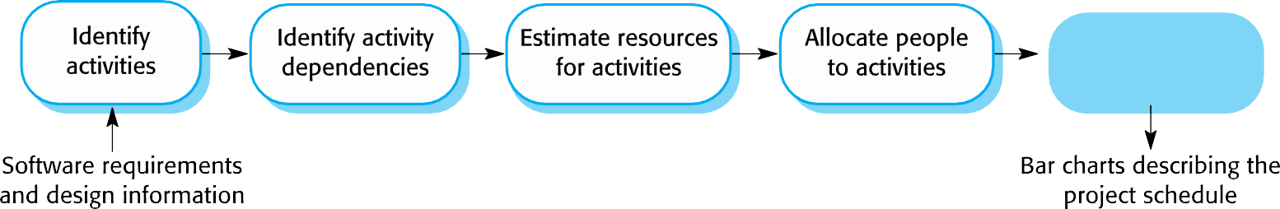
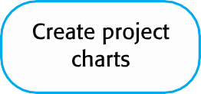
The project scheduling process

Slide 28
Scheduling problems
Estimating the difficulty of problems and hence the cost of developing a solution is hard.
Productivity is not proportional to the number of people
working on a task.
Adding people to a late project makes it later because of communication overheads.
The unexpected always happens. Always allow contingency in planning.

Slide 29
Schedule presentation
Graphical notations are normally used to illustrate the project schedule.
These show the project breakdown into tasks. Tasks should not be too small. They should take about a week or two.
Calendar-based
Bar charts are the most commonly used representation for project schedules. They show the schedule as activities or resources against time.
Activity networks
Show task dependencies

Slide 30
Project activites
Project activities (tasks) are the basic planning element.
Each activity has:
a duration in calendar days or months,
an effort estimate, which shows the number of person-days or
person-months to complete the work,
a deadline by which the activity should be complete,
a defined end-point, which might be a document, the holding of a review meeting, the successful execution of all tests, etc.

Slide 31
Milestones and deliverables
Milestones are points in the schedule against which you can assess progress, for example, the handover of the system for testing.
Deliverables are work products that are delivered to the customer, e.g. a requirements document for the system.

Slide 32
Tasks, Durations, and Dependencies
Task | Effort (person- days) | Duration (days) | Dependencies
T1 | 15 | 10
T2 | 8 | 15
T3 | 20 | 15 | T1 (M1)
T4 | 5 | 10
T5 | 5 | 10 | T2, T4 (M3)
T6 | 10 | 5 | T1, T2 (M4)
T7 | 25 | 20 | T1 (M1)
T8 | 75 | 25 | T4 (M2)
T9 | 10 | 15 | T3, T6 (M5)
T10 | 20 | 15 | T7, T8 (M6)
T11 | 10 | 10 | T9 (M7)
T12 | 20 C | 10 hapter 23 Project Planning | T10, T11 (M8) 31

Slide 33
Activity bar chart

Slide 34
Staff allocation chart

Slide 35
Work Breakdown Structure (WBS)
A Work Breakdown Structure (WBS) is a fundamental project management technique for defining and organizing the total scope of a project, using a hierarchical tree structure.

Slide 36
Work Breakdown Structure (WBS)
17
A work breakdown structure is a key project deliverable that organizes the team’s work into manageable sections
WBS is a foundation document that provides the basis for planning and managing project schedules, costs, resources, and changes
A work package is a task at the lowest level of the WBS

Slide 37
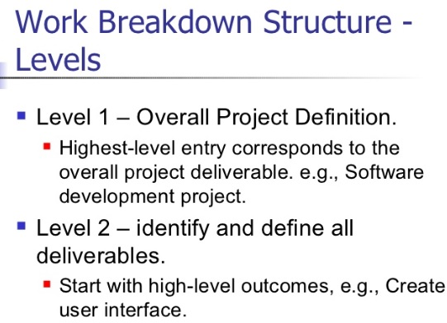

Slide 38
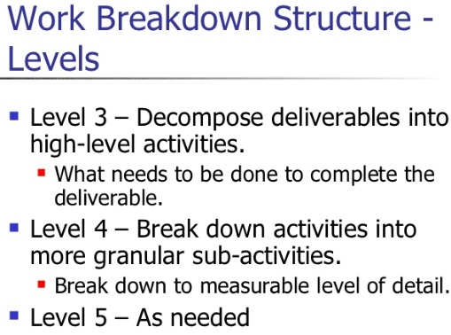

Slide 39
Work Breakdown Structure
18
The project is the overall project under development
1.0
1.2
1.3
1.4
Deliverables are major
project components
1.2.1
1.3.1
1.2.2
1.3.2
Subdeliverables are supporting deliverables
1.2.3
1.2.3.1
Work Packages are individual
1.2.3.2
project activities

Slide 40
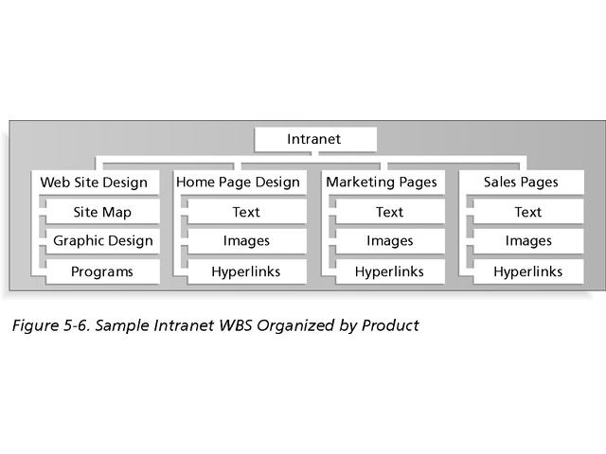
Sample Intranet WBS by Product
Figure shows a WBS for an intranet project. Notice that product areas provide the basis for its organization. In this case, there are main boxes or groupings on the WBS for developing the Web site design, the home page for the intranet, the marketing department’s pages, and the sales department’s pages.

Slide 41
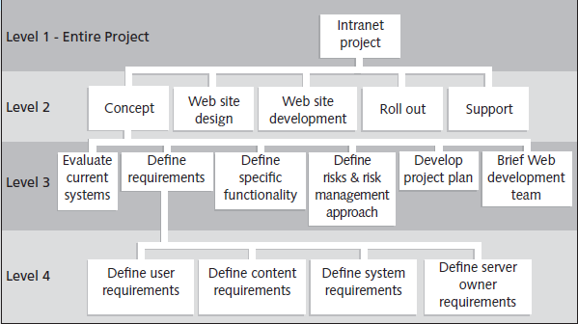
Sample Intranet WBS Organized by Phase

Slide 42
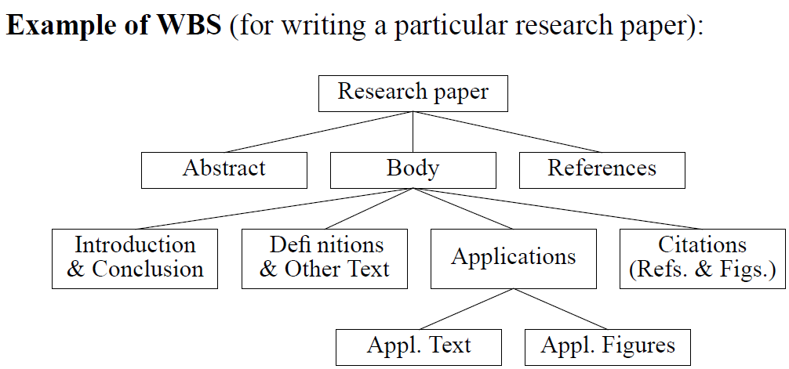

Slide 43
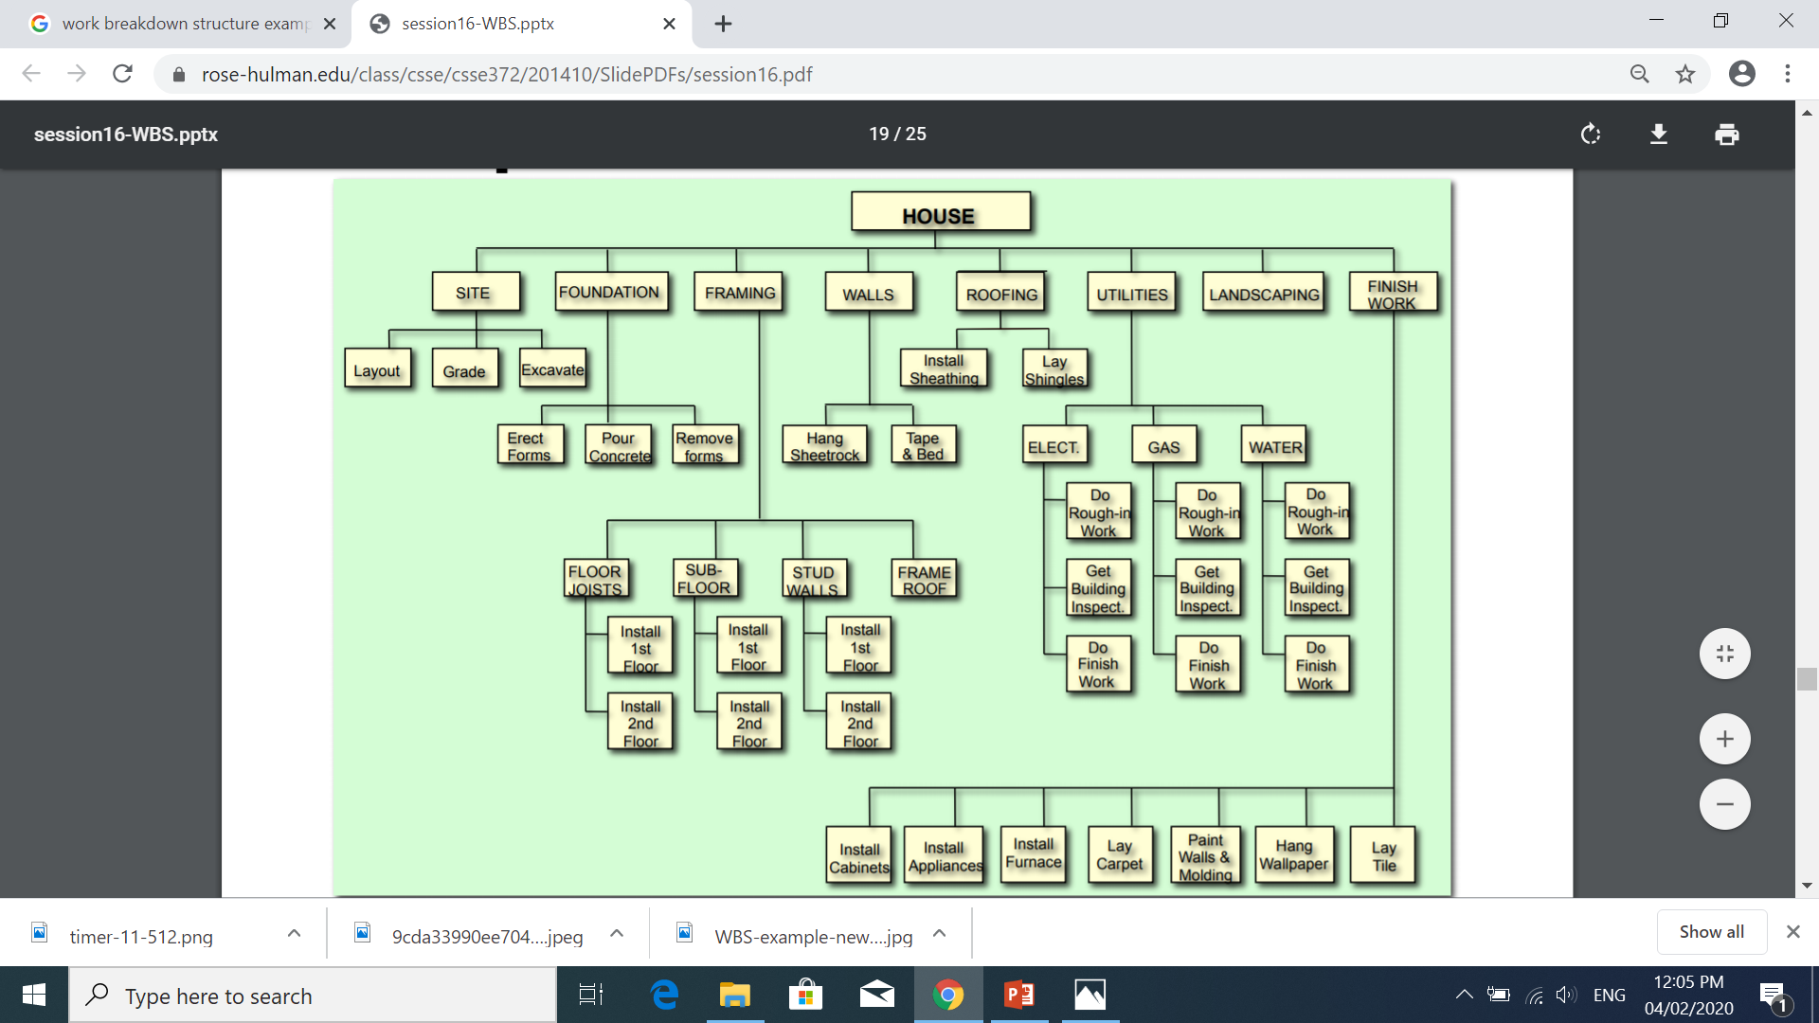

Slide 44
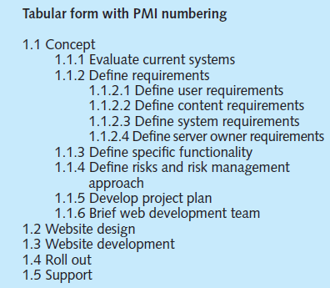
Intranet WBS in Tabular Form

Slide 45
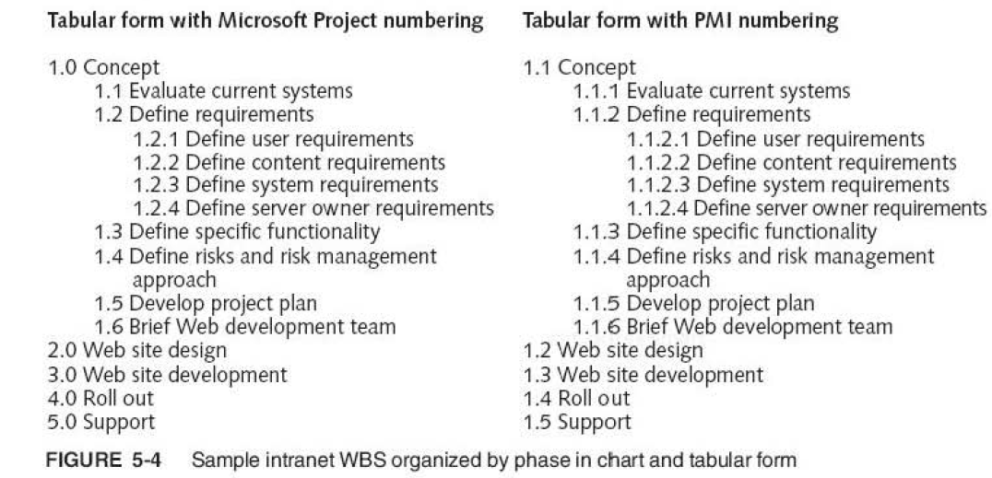

Slide 46
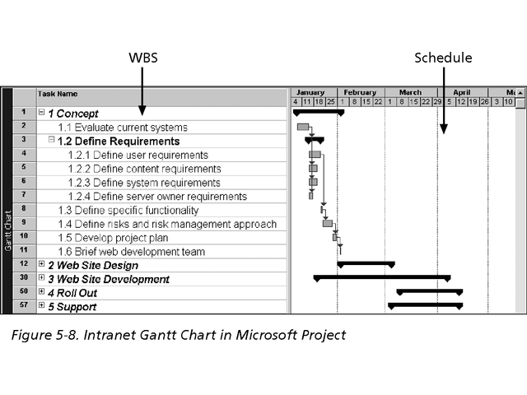
Figure Intranet WBS and Gantt Chart

Slide 47
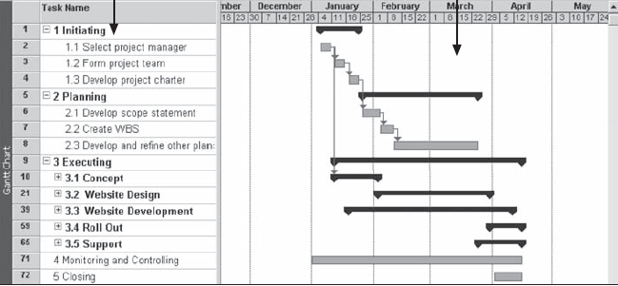

Slide 48
Approaches to developing WBS
Approaches to develop a work breakdown structure:
Using guidelines
The analogy approach
The top-down approach
The bottom-up approach
The mind-mapping approach

Slide 49
Approaches to developing WBS
Guidelines:
If guidelines exist for developing a WBS, it is very important to follow them.
Some organizations, such as the DOD (Department of Defense), provide guidelines for preparing WBSs.
Many DOD projects require contractors to prepare their proposals based on the DOD-provided WBS.
Project managers and their teams should review appropriate information to develop their unique project WBSs more efficiently.

Slide 50
Approaches to developing WBS
Analogy approach: Review WBSs of similar projects and tailor to your project.
McDonnell Aircraft Company, now part of Boeing, provides an example of using an analogy approach when creating WBSs.
McDonnell Aircraft Company designed and manufactured several different fighter aircraft. When creating a WBS for a new aircraft design, it started by using 74 predefined subsystems for building fighter aircraft based on past experience.

Slide 51
Approaches to developing WBS
Top-down approach: Start with the largest items of the project and break them down in subordinate items.
This process involves refining the work into greater and greater levels of detail
Most Project managers consider the top-down approach of WBS construction to be conventional.

Slide 52
Approaches to developing WBS
Bottom-up approach: Start with the specific tasks and roll them up.
Team members first identify as many specific tasks related to the project as possible.
They then aggregate the specific tasks and organize them into summary activities, or higher levels in the WBS.

Slide 53
Approaches to developing WBS
Mind-mapping approach:
Some project managers like to use mind mapping to help develop WBSs
Mind mapping is a technique that uses branches radiating from a core idea to structure thoughts and ideas.
Write tasks in a non-linear, branching format and then create the WBS structure.
Instead of writing down tasks in a list or to create a structure for tasks, mind mapping allows people to write and even draw pictures of ideas in a nonlinear format.

Slide 54
Approaches to developing WBS
Mind-mapping approach: Mind mapping can be used for developing WBSs using the top-down or bottom-up approach.
For example, you could conduct mind mapping for an entire project by listing the project in the center of a document, adding the main categories on branches radiating from the center, and then adding branches for appropriate subcategories. You could also develop a separate mind-mapping diagram for each deliverable and then merge them to create one large diagram for the entire project. You can also add items anywhere on a mind-mapping document without following a strict top-down or bottom-up approach.
After the mind-mapping documents are complete, you can convert them into a chart or tabular WBS form.

Slide 55
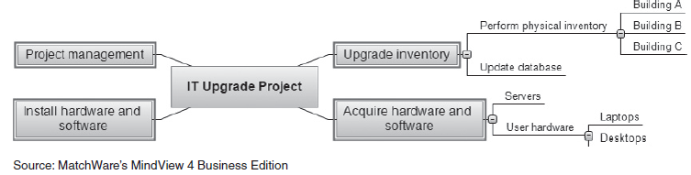
Approaches to developing WBS
Mind-mapping approach: Write tasks in a non-linear, branching format and then create the WBS structure.

Slide 56
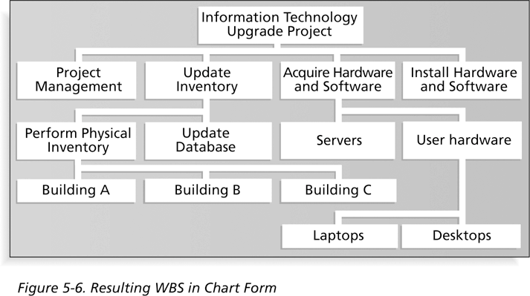
Figure 5-6. Resulting WBS in Chart Form

